Slide 1
A Visual filter for The Learning Registry
Jim Klo (jim.klo@SRI.Com)
SRI International

Slide 2

We can all share
Notes:
Learning Registry is a data network connecting disparate repositories together. Any format, any schema, linked or inline, it’s welcome.

Slide 3

Open mic night all the time
Notes:
We do mean anything by anyone. Metadata, usage data (which we call paradata), service data, anything you can think of and really any format you want. From the largest repository to an individual educator.

Slide 4

A Needle in a Haystack
Notes:
Now that we have all this raw data. How do we find and focus on things we need.

Slide 5
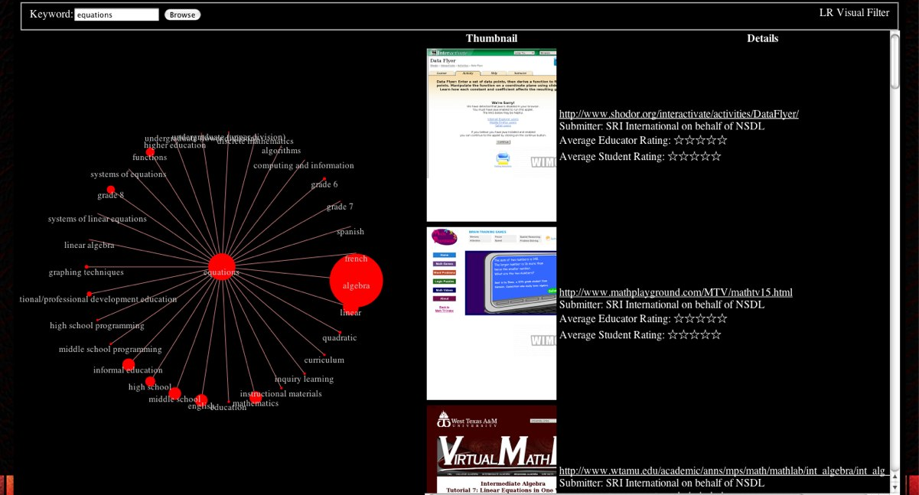

A Visual Approach
Welcome, Ed Cator
Comments: 25 view add
Comments: 36 view add
Notes:
Since the Learning Registry is devoid schema standards, parsing all is not appropriate. Paradata formats are more limited – we can drive an implementation to parse a few. This is an HTML 5 approach, which makes the solution more device agnostic.

Slide 6


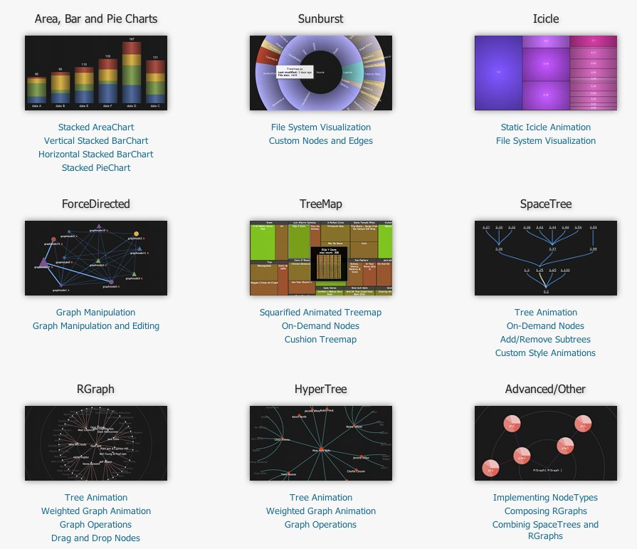
Multiple Options
Thumbnail Service:
W<IMG
http://wimg.ca
HTML5 Graphs:
JavaScript InfoVis Toolkit
http://thejit.org
Notes:
The demo uses a HTML 5 visualization toolkit that is multi-device compatible.

